Slide 1



OPPORTUNITY REVIEW
DIRECT-TO-EMPLOYER GTM STRATEGY
Exploring a Mosaic Life Care DTE Health Plan

Slide 2


Founded in 1979, headquartered in Indianapolis
Largest Independently-Owned Full-Service Third-Party Administrator
Specialize in Administration of Self-Funded Plans and Population Health Management​
Leader in the Direct-to-Employer Movement
We Know and Understand the Market
Experience Working with All Professional Teams: Agents, Networks, MGAs
The Key Family of Companies is a Vertically Integrated group of benefit related organizations
3,000+ Corporate Clients
3 Million Members under Management
700 Employees

Slide 3


MARKET LEADER
IN
PRIVATE LABELED
DTE PLANS
Louisville, KY
OneHealth Plan
Cincinnati, OH
TCH Optimal
Bentonville, AR
Northwest Health Plan
Knoxville, TN
East Tennessee Health Plan
Meridian, MS
Affinity Health Plan
Fort Myers, FL
Lee Health Care Partners

Slide 4


DIRECT-TO-EMPLOYER (DTE)
YOU Pick the Name of the Health Plan
YOU Determine the Fees Charged
YOU Practice the Medicine
YOU Receive the Profits
WE Make it Successful
Your Health Plan Focused on a Direct Relationship with Self-Funded Employers in Your Market

Slide 5
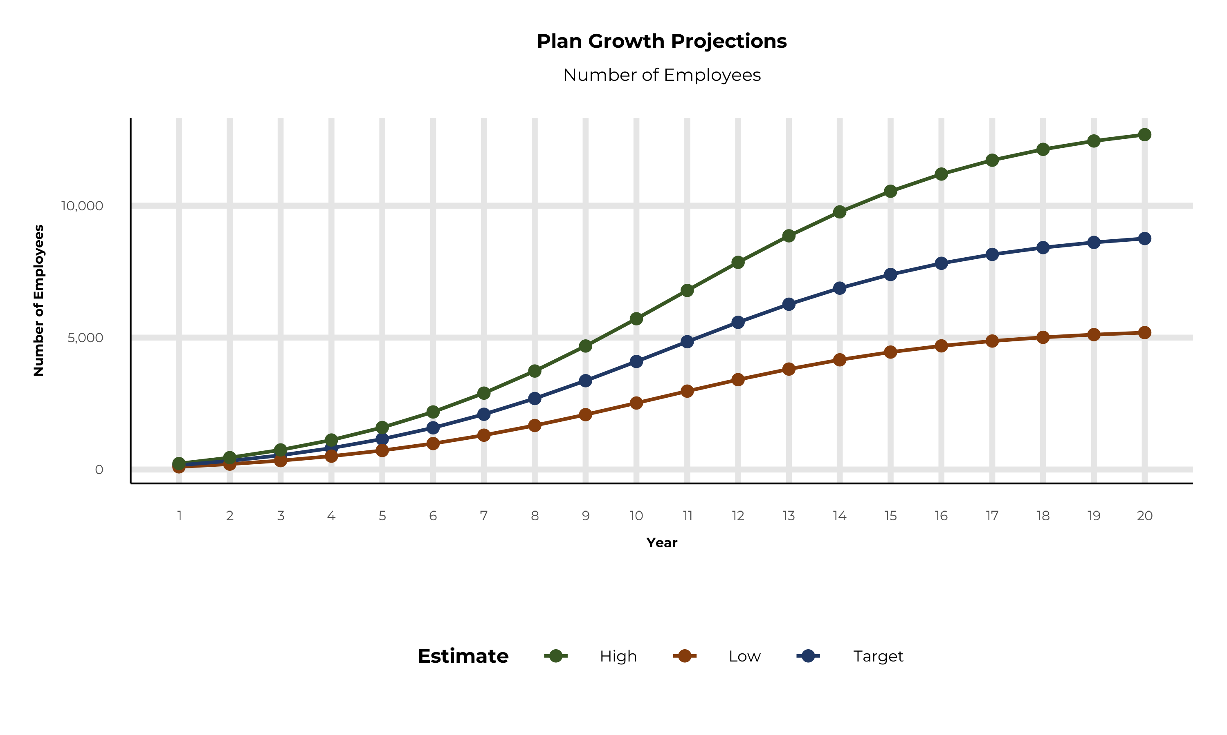
PLAN POTENTIAL GROWTH PATHS
Self Funded
60K
Insured
99K
Working Age
139K
Population
246K
Estimates includes the Mosaic Life Care service area in Page, Taylor, Atchison, Doniphan, Andrew, Buchanan, Clay, Clinton, Daviess, DeKalb, Gentry, Harrison, Holt, Nodaway, Platte, and Worth Counties

Slide 6
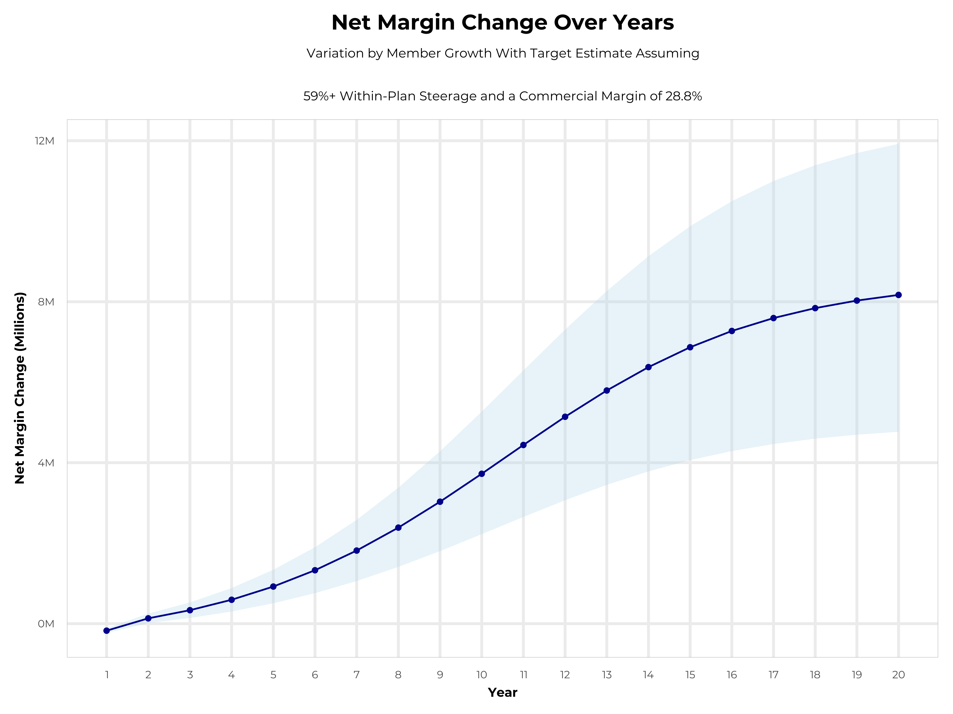
INCREASING GROWTH AND PROFITABILITY
Early Stage
Gaining Name Recognition, Early Growth
New Revenue:
New Profit:
$2.46M
$0.52M
Growth Stage
Strong Reputation, Strong Growth
New Revenue:
New Profit:
$13.34M
$3.76M
Mature Stage
High Profitability, Market Saturation
New Revenue:
New Profit:
$25.82M
$7.45M

Slide 7
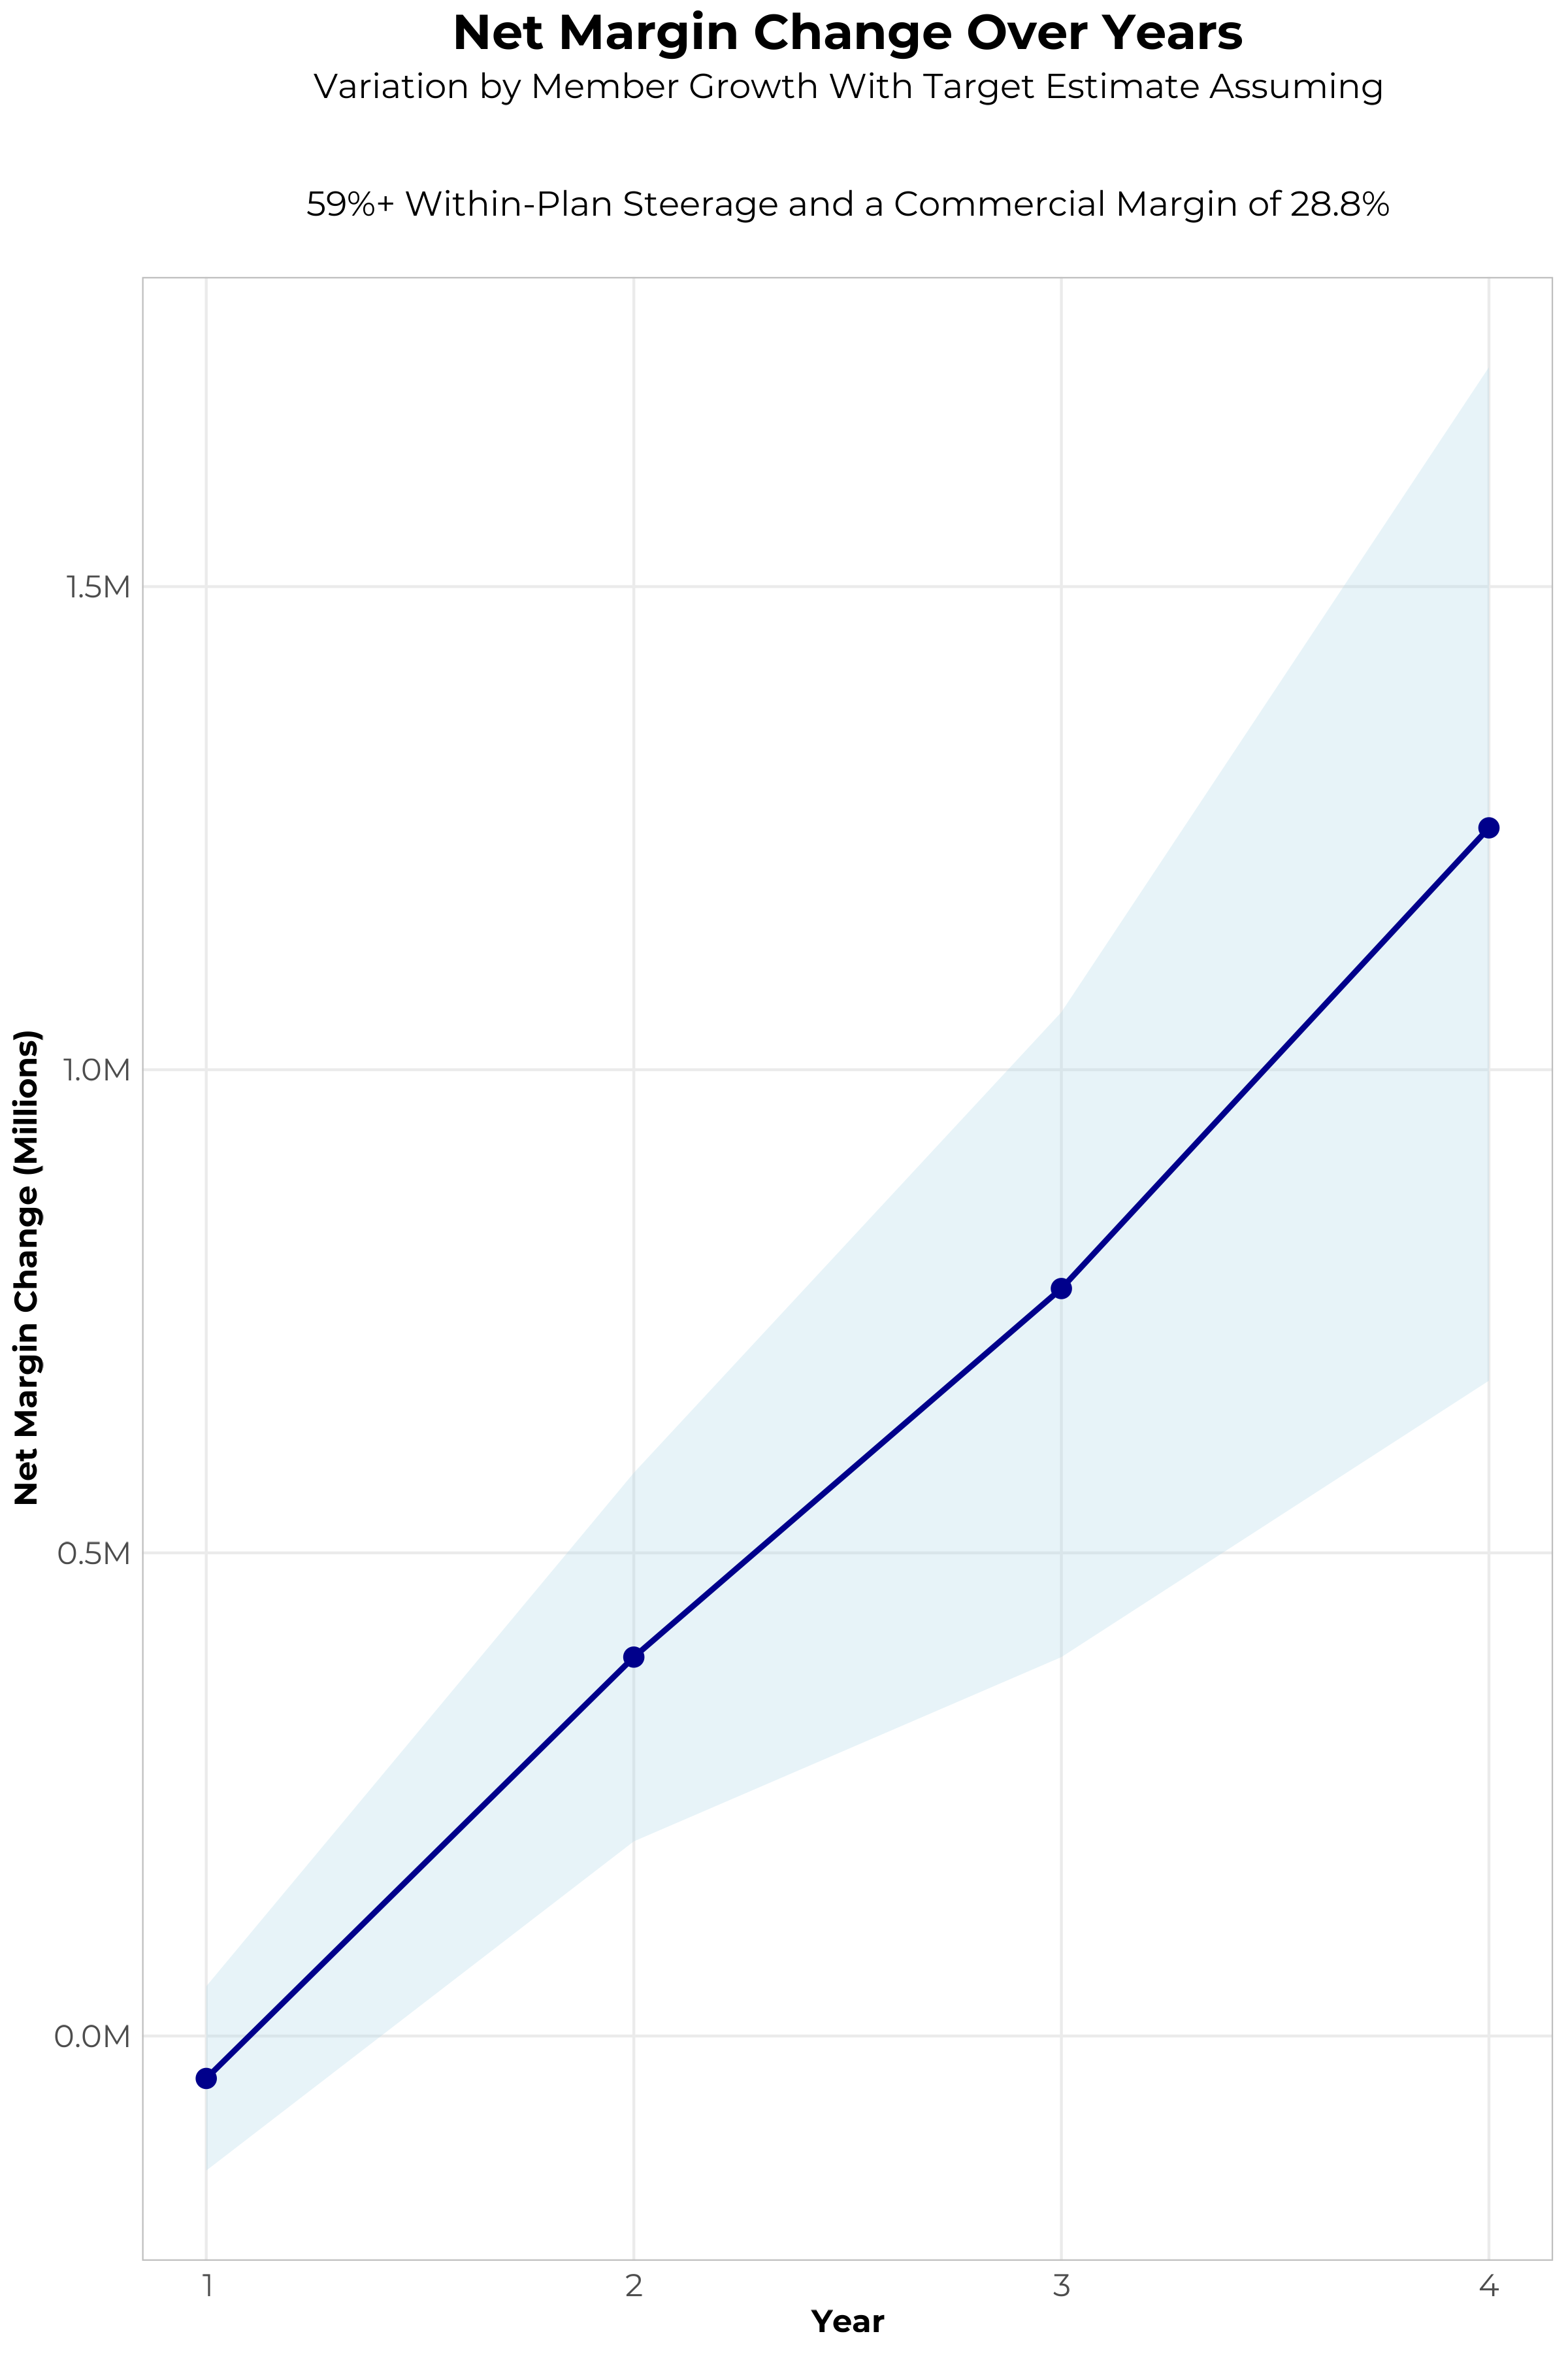
FOUR-YEAR PROJECTIONS
Target Member Growth | Target Member Growth | Target Member Growth | Target Member Growth | Target Member Growth
Metric | Year 1 | Year 2 | Year 3 | Year 4
Number of Members | 300 | 600 | 1,000 | 1,500
Incremental Margin | 282.5K | 564.9K | 941.5K | 1,412.3K
Network Access Fee | 3.6K | 7.2K | 12.0K | 18.0K
Implementation Fee (One-Time) | -150.0K | 0.0K | 0.0K | 0.0K
Sales and Marketing Costs | -180.0K | -180.0K | -180.0K | -180.0K
Net Margin Change | -43.9K | 392.1K | 773.5K | 1,250.3K
High Member Growth | High Member Growth | High Member Growth | High Member Growth | High Member Growth
Metric | Year 1 | Year 2 | Year 3 | Year 4
Number of Members | 400 | 800 | 1,300 | 2,000
Incremental Margin | 376.6K | 753.2K | 1,224.0K | 1,883.1K
Network Access Fee | 4.8K | 9.6K | 15.6K | 24.0K
Implementation Fee (One-Time) | -150.0K | 0.0K | 0.0K | 0.0K
Sales and Marketing Costs | -180.0K | -180.0K | -180.0K | -180.0K
Net Margin Change | 51.4K | 582.8K | 1,059.6K | 1,727.1K
Low Member Growth | Low Member Growth | Low Member Growth | Low Member Growth | Low Member Growth
Metric | Year 1 | Year 2 | Year 3 | Year 4
Number of Members | 200 | 400 | 600 | 900
Incremental Margin | 188.3K | 376.6K | 564.9K | 847.4K
Network Access Fee | 2.4K | 4.8K | 7.2K | 10.8K
Implementation Fee (One-Time) | -150.0K | 0.0K | 0.0K | 0.0K
Sales and Marketing Costs | -180.0K | -180.0K | -180.0K | -180.0K
Net Margin Change | -139.3K | 201.4K | 392.1K | 678.2K

Slide 8
DIRECT-TO-EMPLOYER STRATEGY: ONLY AVAILABLE TO PREMIER HEALTH SYSTEMS
STRONG Brand Quality
EXTENSIVE Patient Access
AFFORDABLE Value Pricing
EXCELLENT Care Quality

Slide 9
YEAR 4 PROJECTED REVENUE AND PROFIT
Pre-DTE Cohort of 1,500 Employees | Inpatient | Outpatient | Professional | Total
Revenue† | $ 3,952,471 | $ 3,991,446 | $ 1,863,971 | $ 9,807,888
Net Income‡ | $ 1,138,312 | $ 1,149,536 | $ 536,823.7 | $ 2,824,672
† Assuming proportional revenues from market shares of 89% (inpatient) and 49% (outpatient)
‡ Conservatively assuming a commercial margin of 28.8% (80% of the estimated commercial margin)
With DTE | Inpatient | Outpatient | Professional | Total
Revenue⁰ | $ 3,994,874 | $ 7,262,767 | $ 3,391,651 | $ 14,649,292
Net Income* | $ 1,150,524 | $ 2,091,677 | $ 976,795.4 | $ 4,218,996
⁰ Assuming 90% inpatient and 90% market steerage based on KBA narrow network DTE experience (see previous slide)
* Conservatively assuming a commercial margin of 28.8%, with a 10 percentage-point reduction to reflect competitive-edge rates and a 10 percentage-point increase due to lower billing costs and higher patient responsibility collections because of the member credit card.
Total Increase in Net Income | $ 1,394,324
Network Access Fee (Revenue) of $1 PMPM | $ 18,000
Total Profit Growth | $ 1,399,124
Minus Implementation Fee (One-Time) | -$ 0
Minus Sales and Marketing (Annual – Ongoing) | -$ 180,000
Total | $ 1,232,324

Slide 10





A PARTNER YOU CAN TRUST
OUR OBJECTIVES ARE ALIGNED
WE KNOW THE
MARKET
COMPLETELY TRANSPARENT
WE HAVE THE SOPHISTICATION AND INFRASTRUCTURE TO EFFECTIVELY COMPETE
Derek Moore, Senior Vice President – KBA
845-283-9973 * derek.moore@keybenefit.com

